Slide 1

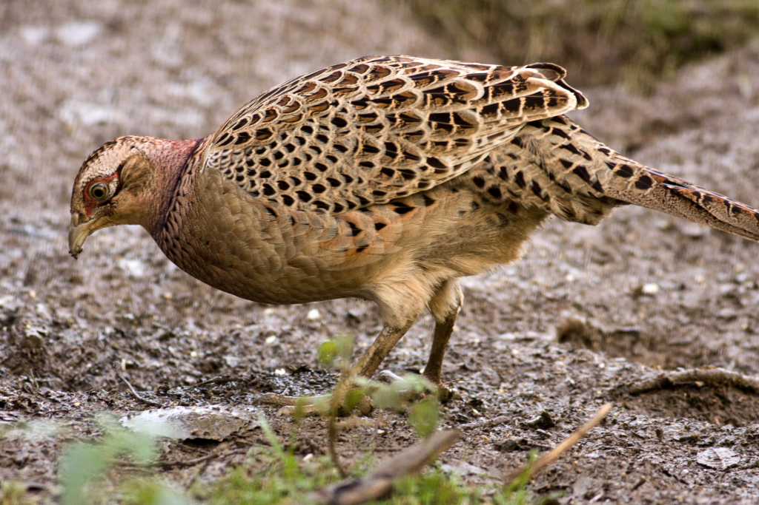
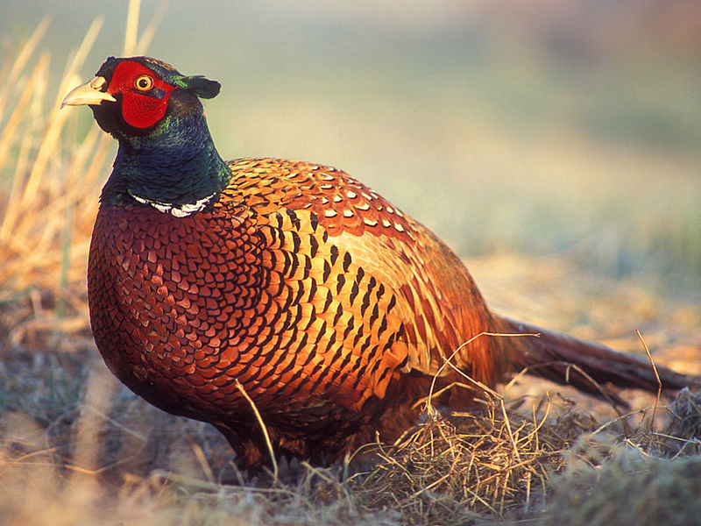
Newcomb, HR. 1940. Ring-necked pheasant studies on Protection Island in the Strait of Juan de Fuca, Washington. MS thesis. Oregon State University.
Video
Photo credit: Andy Vernon
Photo credit: Lukasz Lukasik

Slide 2
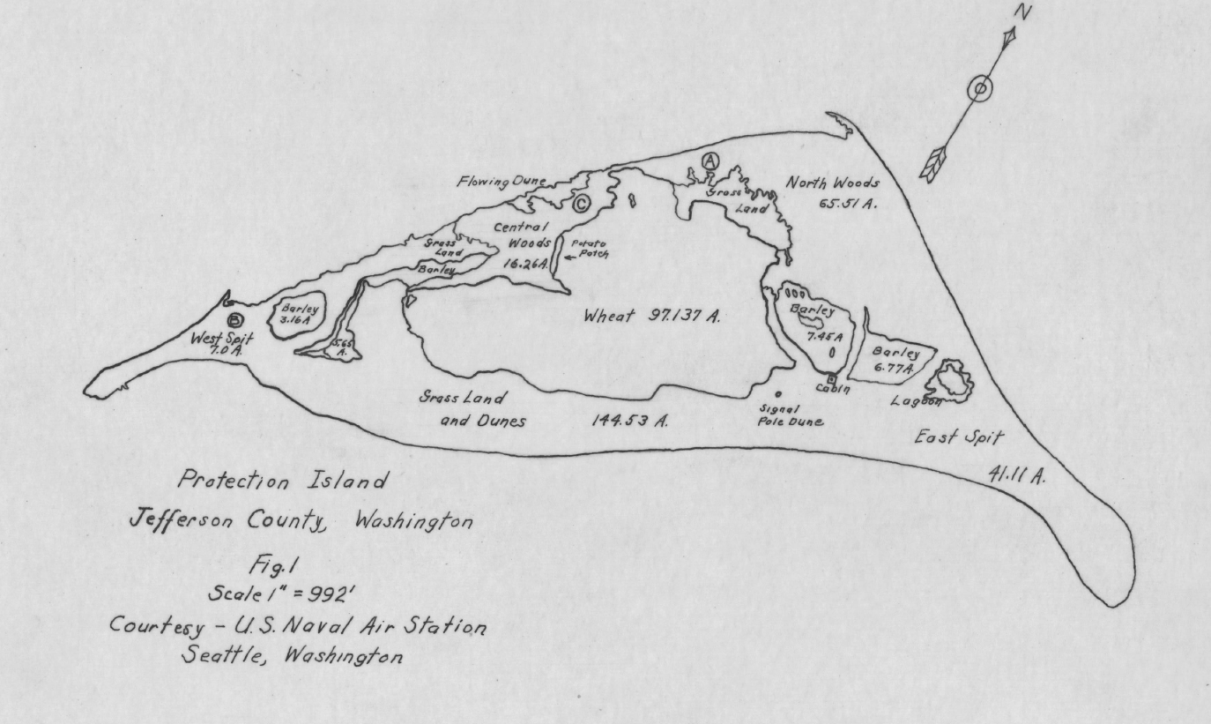
Newcomb, HR. 1940. Ring-necked pheasant studies on Protection Island in the Strait of Juan de Fuca, Washington. MS thesis. Oregon State University.

Slide 3
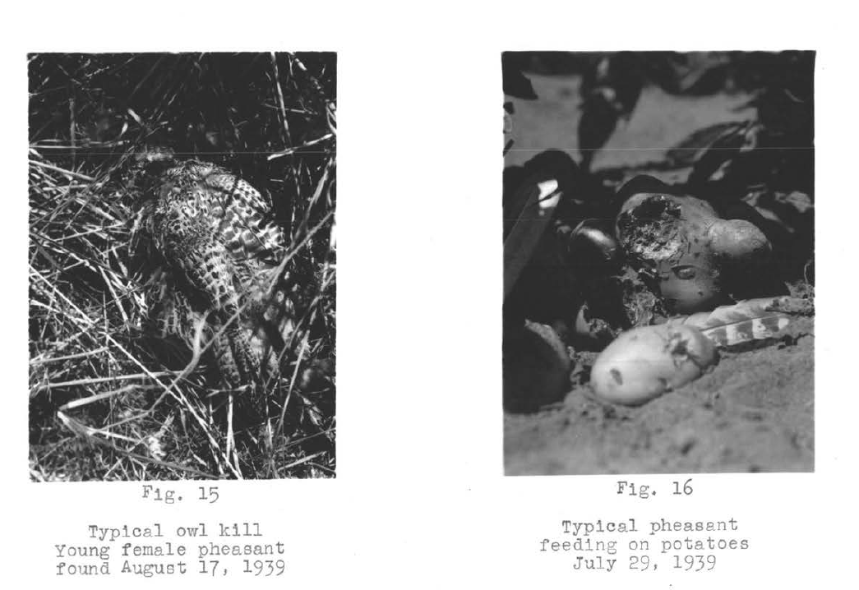
Newcomb, HR. 1940. Ring-necked pheasant studies on Protection Island in the Strait of Juan de Fuca, Washington. MS thesis. Oregon State University.

Slide 4
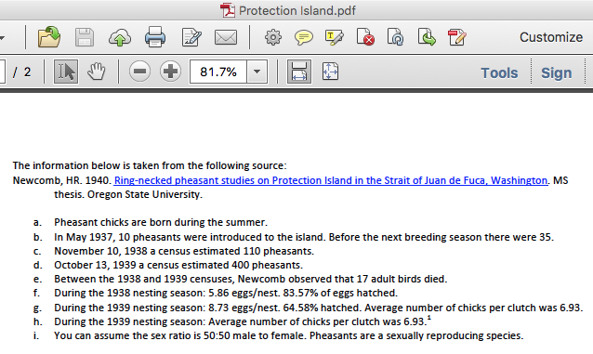
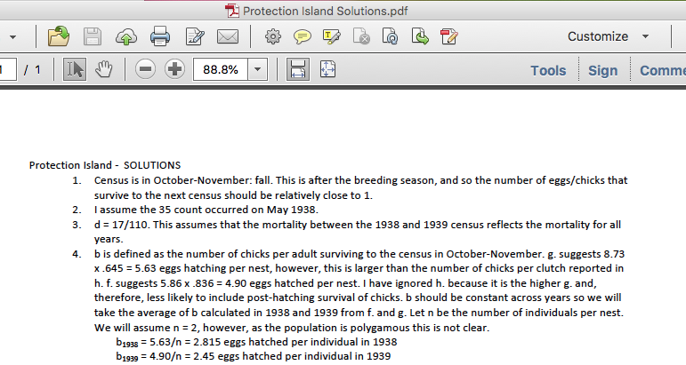

Slide 5
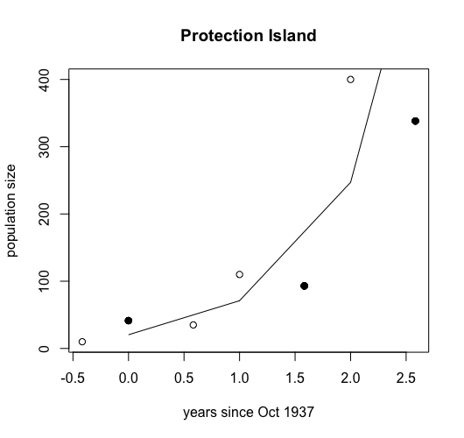
Notes:
Black dots are inferred based on natural mortality of 17/110 and assuming October is post reproduction.

Slide 6
Geometric growth
The equations we have seen so far are called ‘discrete time’. This equation is appropriate for populations that have regular, pulse reproduction.
For example, pheasants reproduce once per year in the summer.
Can you think of examples of other species that reproduce like this?
Notes:
Answer: fish, mammals, plants

Slide 7
Exponential growth
Can you think of any species that reproduce continuously throughout the year?
These species are better modelled with a continuous time model
Notes:
Answer: bacteria; humans

Slide 8
Exponential growth (continuous time)
Let N(t) be the popn size at time t
The slope of a graph of population size versus time
The instantaneous rate of change in the popn size, N(t)

Slide 9
Exponential growth
The population is growing exponentially with time
r = 0.5
What is the slope of the tangent line?

Slide 10
Exponential growth in continuous time
b: is the per capita birth rate (1/time)
d: is the per capita death rate (1/time)
r = b-d: intrinsic rate of natural increase (1/time)

Slide 11
Discrete time
Continuous time
The population is increasing if N_{t+1} > N_{t}
For what values of λ does the population size increase?
The population is increasing if > 0
For what values of r does the population size increase?
Notes:
ANSWER: Lambda > 1; r > 0

Slide 12
Solving the exponential growth equation – continuous time

Slide 13
Discrete time
Continuous time
Used for populations that have regular pulse reproduction, e.g. pheasants
The population is increasing if N_{t+1} > N_{t}
λ is non-negative (positive or zero)
Popn grows if λ > 1
λ = 1+b-d and is called the finite rate of population growth
Used for populations that reproduce continuously, e.g. bacteria
The population is increasing if . > 0
r can be positive or negative
Popn grows if r > 0
r = b-d and is called the intristic rate of natural increase
Notes:
ANSWER: Lambda > 1; r > 0

Slide 14
Summary
Exponential growth assumes that all individuals in the population have the same chance of dying and produce the same number of offspring. These do no change over time.
We can use the mathematical formulas to predict the size of the population in the future

